Slide 1




Code Innovators
Presented by :
Manasa P & Nikhil K
CodeSight AI
COT6930

Slide 2


CODESIGHT AI
CodeSight AI is a smart developer assistant that simplifies how teams understand, modify, and maintain software projects. Modern codebases are complex, and even small changes can cause unexpected issues. Instead of manually searching through files or guessing the impact, CodeSight AI uses Generative AI to read project structures, analyze change requests, generate code, and even apply updates automatically. With project-aware reasoning and natural-language interaction, it helps developers work faster, reduce mistakes, and manage changes with confidence.

Slide 3


“Understanding the impact of software changes is one of the hardest and most time-consuming tasks in modern development.”
Small changes lead to hidden breakages.
Manual impact tracing is slow and error-prone.
Tools don’t understand natural language.
No unified AI assistant for change management.
Privacy limits external AI usage.
Problem Statement

Slide 4

Project Overview
CodeSight AI is an end-to-end GenAI-powered developer assistant that helps engineers understand, analyze, and automatically update large codebases.
It combines multi-agent architecture, impact analysis, automatic code fixing, GitHub import, and a beautiful Streamlit UI.
This tool works with ANY GitHub repository (public or private) and supports any programming language.
www.reallygreatsite.com

Slide 5



Code Innovators
Solution 01
AI-Powered Impact Analysis
Understands natural-language requirements
Scans the entire repo and identifies impacted files
Categorizes changes as High / Medium / Low impact
Prevents regressions and missed dependencies
Solution 02
Intelligent Repo Understanding
Automatically summarizes any GitHub project
Explains files, modules, and structure in simple English
Provides project-aware chatbot responses based on real code
Our Innovative Solutions
Solution 03
Automated Code Suggestions
Reviews pasted code for bugs, security issues, and improvements
Gives clean, actionable suggestions using best practices

Slide 6
Code Innovators
Solution 04
AI Code Generation
Converts English descriptions into runnable, structured code
Adds comments, helper functions, and proper architecture patterns
Solution 05
Automatic Fixer for Impacted Files
Identifies affected files using Impact Analyzer
Rewrites or updates those files using AI
Saves time on manual fixes and reduces developer effort
Our Innovative Solutions
Solution 06
Local, Privacy-Friendly Execution
Processes all code locally after GitHub import
No code is sent to external servers
Ensures 100% privacy and security for private repositories

Slide 7

Model
Development
Multi-agent LLM architecture using Gemini 2.5
Agents for parsing, impact analysis, code generation, & auto-fixing
Project-aware reasoning using file paths + code snippets
Structured prompts for consistent, accurate impact reports
Local execution for secure and private processing
Performance optimized with snippet-based input and file filtering

Slide 8

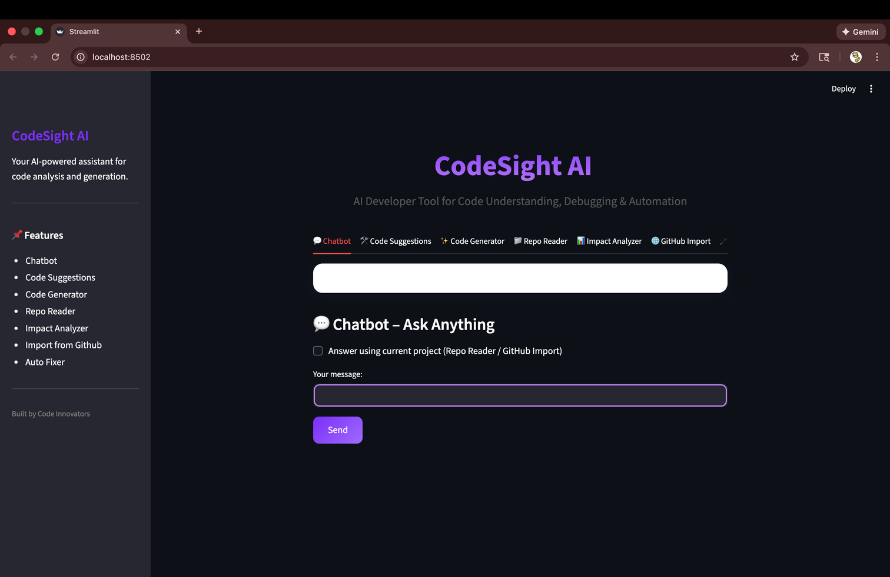
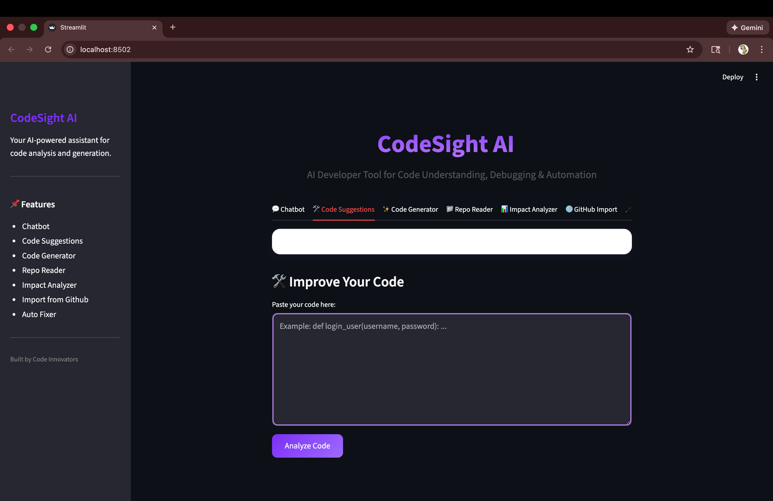
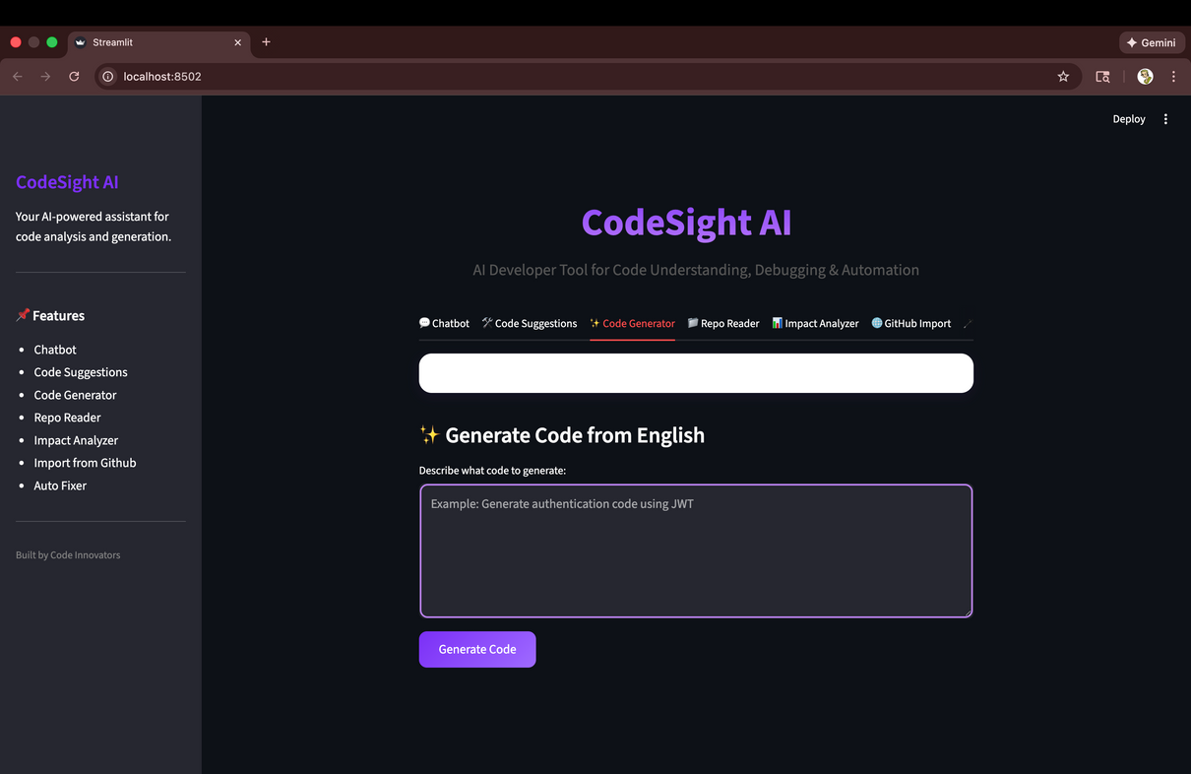
Discover Our Services
01
AI Chatbot —
Conversational assistant for general queries and technical explanations.
02
Code Suggestions
— Identifies bugs, improvements, and best practices in your code.
03
Code Generator
— Converts natural-language requests into clean, runnable code.

Slide 9
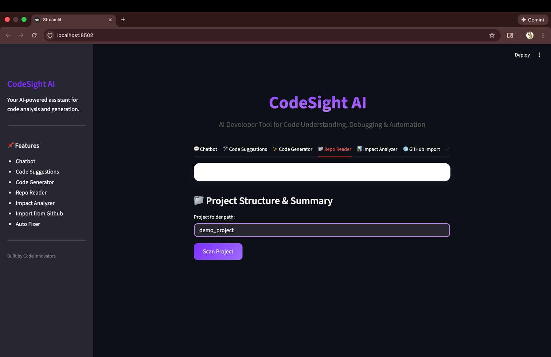
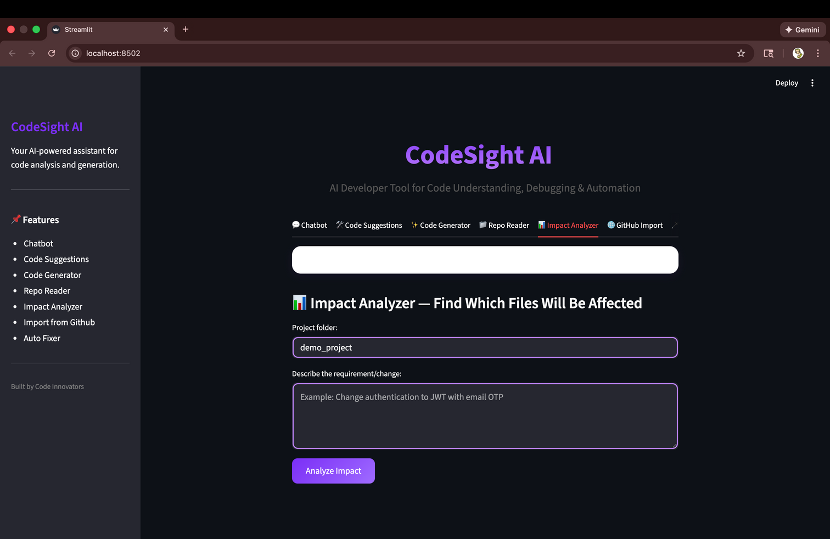
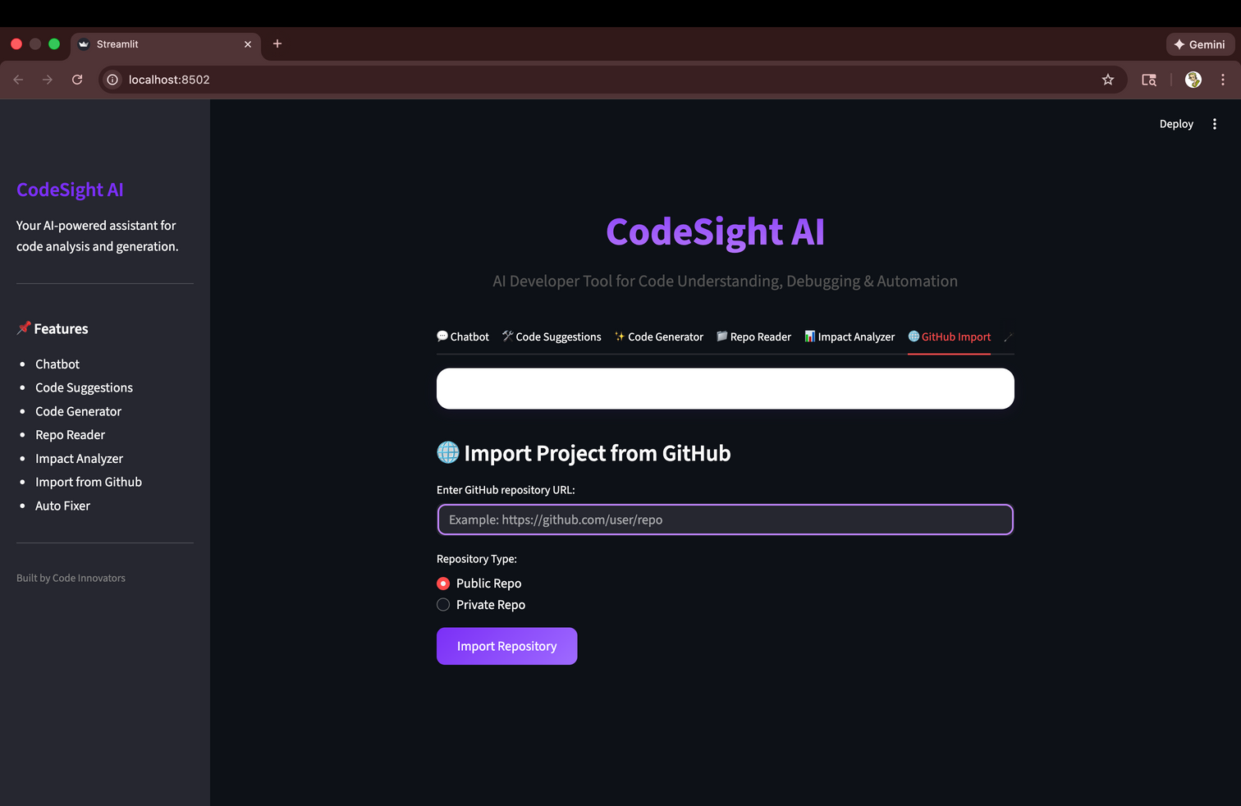
Discover Our Services
Repo Reader —
Summarizes any GitHub project: structure, modules, responsibilities.
Impact Analyzer —
Detects which files/functions are affected by any requirement or change.
GitHub Import
— Imports and processes any public/private repository securely.
04
05
06

Slide 10

Future Directions
In the future, CodeSight AI can evolve into a more powerful development companion by integrating semantic code search, supporting additional programming languages, and offering deeper multi-agent reasoning. The system could expand into IDE plugins for VS Code, enabling real-time assistance as developers write code. Additional features such as automated test case generation, AI-driven refactoring, and interactive dependency visualizations would further enhance its capabilities. Long-term improvements may also include full offline support using local models, making CodeSight AI both more private and accessible for enterprise use.

Slide 11

Code
Innovators
Presented by :
Manasa P & Nikhil K
Thank You
mpatil2024@fau.edu
for your time and attention
skuntannagar2024@fau.edu

